Slide 1
Virtual Memory
--page replacement

Slide 2
Page Replacement
Prevent over-allocation of memory by modifying page-fault service routine to include page replacement
Use modify (dirty) bit to reduce overhead of page transfers – only modified pages are written to disk
Page replacement completes separation between logical memory and physical memory – large virtual memory can be provided on a smaller physical memory

Slide 3
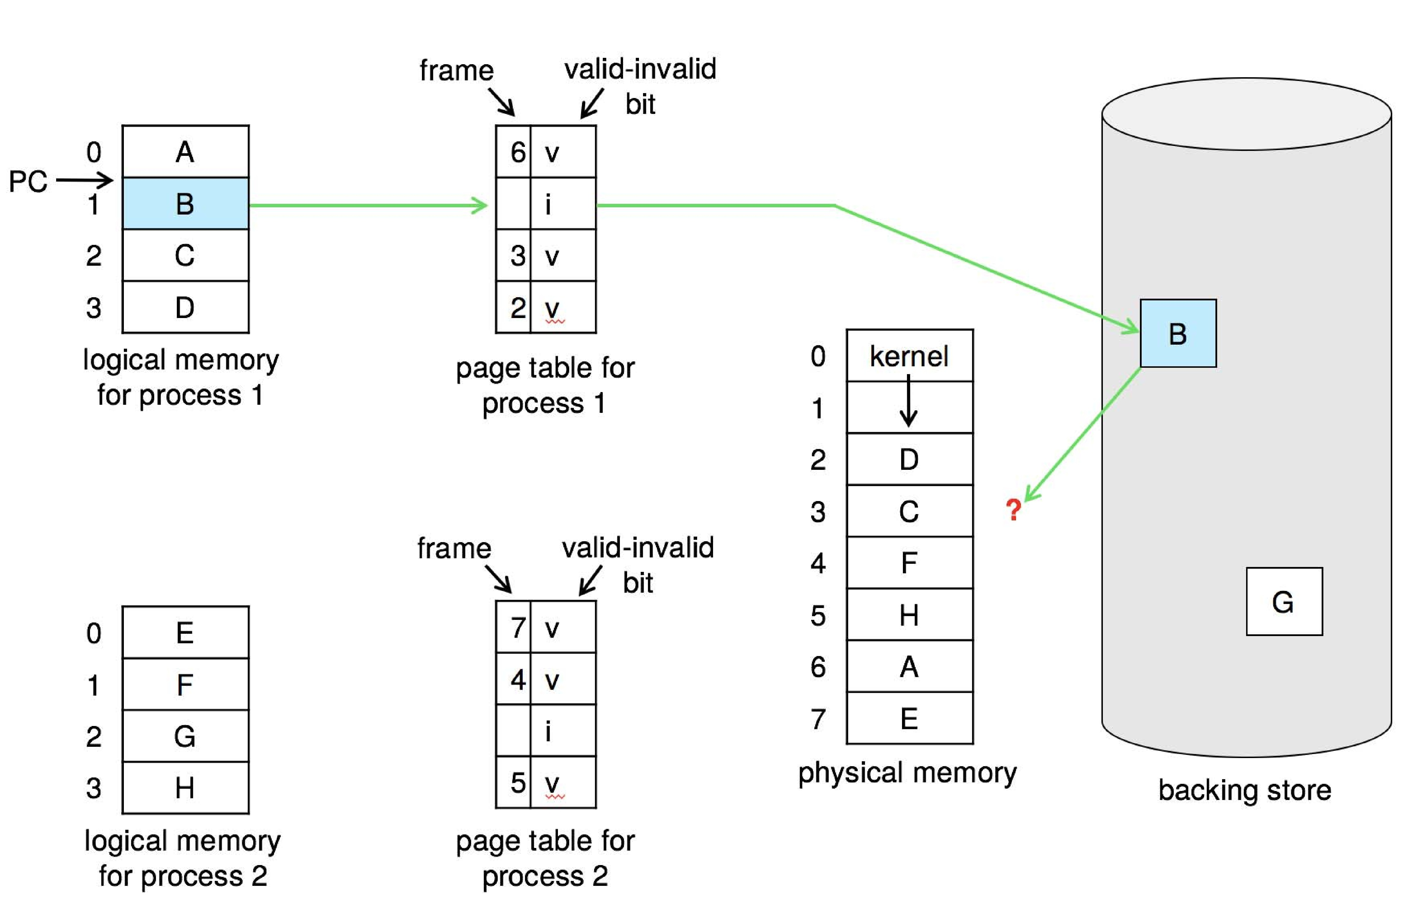
Need For Page Replacement

Slide 4
Basic Page Replacement
Find the location of the desired page on disk
Find a free frame:
- If there is a free frame, use it
- If there is no free frame, use a page replacement algorithm to select a victim frame
- Write victim frame to disk if dirty
Bring the desired page into the (newly) free frame; update the page and frame tables
Continue the process by restarting the instruction that caused the trap
Note now potentially 2 page transfers for page fault – increasing EAT

Slide 5

Page Replacement

Slide 6
Page and Frame Replacement Algorithms
Frame-allocation algorithm determines
  How many frames to give each process
  Which frames to replace
Page-replacement algorithm
  Want lowest page-fault rate on both first access and re-access
Evaluate algorithm by running it on a particular string of memory references (reference string) and computing the number of page faults on that string
  String is just page numbers, not full addresses
  Repeated access to the same page does not cause a page fault
  Results depend on number of frames available

Slide 7

Graph of Page Faults Versus The Number of Frames
In all our examples, the reference string of referenced page numbers is
7,0,1,2,0,3,0,4,2,3,0,3,0,3,2,1,2,0,1,7,0,1

Slide 8

First-In-First-Out (FIFO) Algorithm
Reference string: 7,0,1,2,0,3,0,4,2,3,0,3,0,3,2,1,2,0,1,7,0,1
3 frames (3 pages can be in memory at a time per process)
15 page faults\

Slide 9
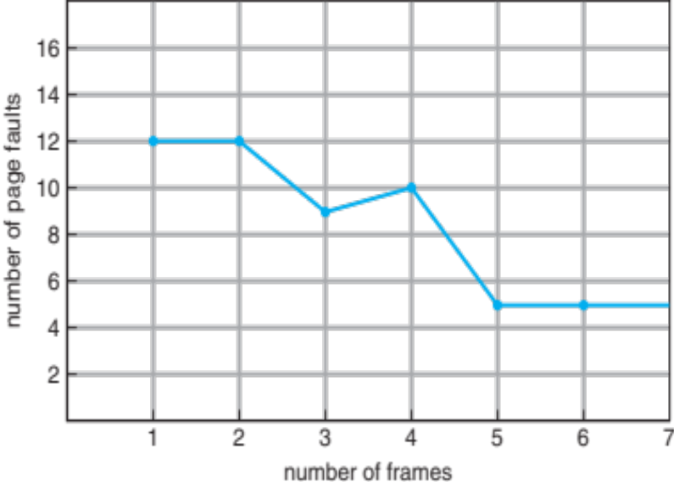
FIFO Illustrating Belady’s Anomaly
Can vary by reference string: consider 1,2,3,4,1,2,5,1,2,3,4,5
  Adding more frames can cause more page faults!
    Belady’s Anomaly
How to track ages of pages?
  Just use a FIFO queue

Slide 10

Optimal Algorithm
Replace page that will not be used for longest period of time
  9 is optimal for the example
How do you know this?
  Can’t read the future
Used for measuring how well your algorithm performs

Slide 11

Least Recently Used (LRU) Algorithm
Use past knowledge rather than future
Replace page that has not been used in the most amount of time
Associate time of last use with each page
12 faults – better than FIFO but worse than OPT
Generally good algorithm and frequently used
But how to implement?

Slide 12
LRU Algorithm (Cont.)
Counter implementation
  Every page entry has a counter; every time page is referenced through this entry, copy the clock into the counter
  When a page needs to be changed, look at the counters to find smallest value
    Search through table needed
Stack implementation
  Keep a stack of page numbers in a double link form:
  Page referenced:
    move it to the top
    requires 6 pointers to be changed
  But each update more expensive
  No search for replacement
LRU and OPT are cases of stack algorithms that don’t have Belady’s Anomaly

Slide 13
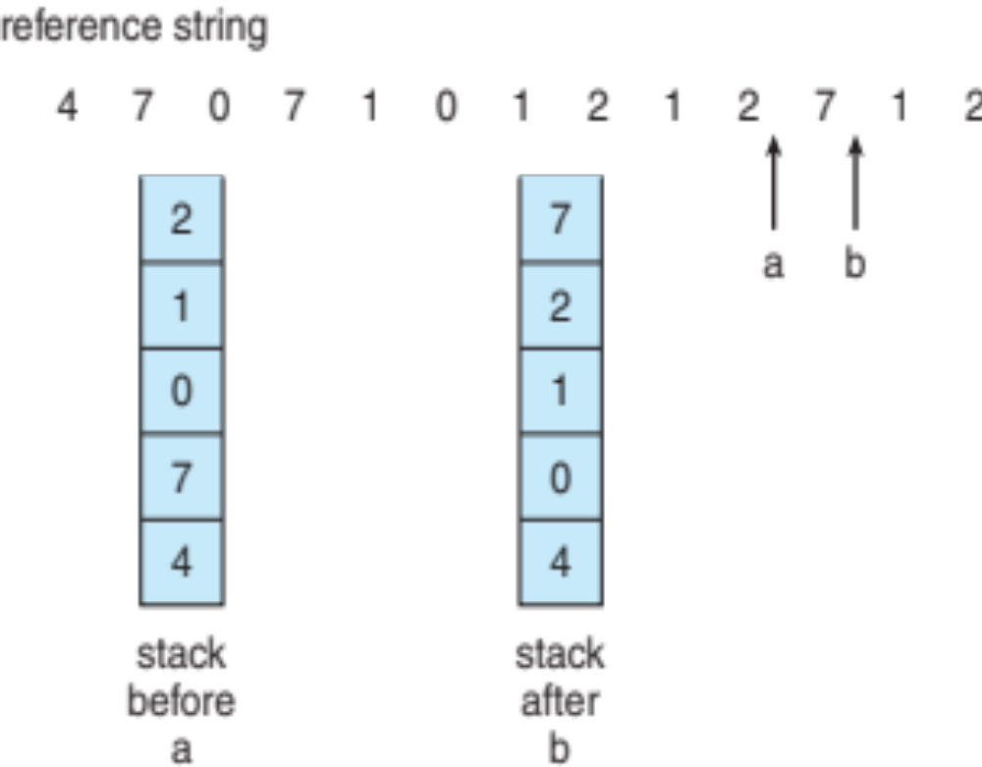
Use Of A Stack to Record Most Recent Page References

Slide 14
LRU Approximation Algorithms
LRU needs special hardware and still slow
Reference bit
  With each page associate a bit, initially = 0
  When page is referenced bit set to 1
  Replace any with reference bit = 0 (if one exists)
    We do not know the order, however
Second-chance algorithm
  Generally FIFO, plus hardware-provided reference bit
  Clock replacement
  If page to be replaced has
    Reference bit = 0 -> replace it
    reference bit = 1 then:
      set reference bit 0, leave page in memory
      replace next page, subject to same rules

Slide 15

Second-Chance (clock) Page-Replacement Algorithm

Slide 16
Enhanced Second-Chance Algorithm
Improve algorithm by using reference bit and modify bit (if available) in concert
Take ordered pair (reference, modify):
  (0, 0) neither recently used not modified – best page to replace
  (0, 1) not recently used but modified – not quite as good, must write out before replacement
  (1, 0) recently used but clean – probably will be used again soon
  (1, 1) recently used and modified – probably will be used again soon and need to write out before replacement
When page replacement called for, use the clock scheme but use the four classes replace page in lowest non-empty class
  Might need to search circular queue several times

Slide 17
Counting Algorithms
Keep a counter of the number of references that have been made to each page
  Not common
Lease Frequently Used (LFU) Algorithm: replaces page with smallest count
Most Frequently Used (MFU) Algorithm: based on the argument that the page with the smallest count was probably just brought in and has yet to be used

Slide 18
Page-Buffering Algorithms
Keep a pool of free frames, always
  Then frame available when needed, not found at fault time
  Read page into free frame and select victim to evict and add to free pool
  When convenient, evict victim
Possibly, keep list of modified pages
  When backing store otherwise idle, write pages there and set to non-dirty
Possibly, keep free frame contents intact and note what is in them
  If referenced again before reused, no need to load contents again from disk
  Generally useful to reduce penalty if wrong victim frame selected

Slide 19
Applications and Page Replacement
All of these algorithms have OS guessing about future page access
Some applications have better knowledge – i.e. databases
Memory intensive applications can cause double buffering
  OS keeps copy of page in memory as I/O buffer
  Application keeps page in memory for its own work
Operating system can given direct access to the disk, getting out of the way of the applications
  Raw disk mode
Bypasses buffering, locking, etc

Slide 20
Allocation of Frames
Each process needs minimum number of frames
Example: IBM 370 – 6 pages to handle SS MOVE instruction:
  instruction is 6 bytes, might span 2 pages
  2 pages to handle from
  2 pages to handle to
Maximum of course is total frames in the system
Two major allocation schemes
  fixed allocation
  priority allocation
Many variations

Slide 21


Fixed Allocation
Equal allocation – For example, if there are 100 frames (after allocating frames for the OS) and 5 processes, give each process 20 frames
  Keep some as free frame buffer pool
Proportional allocation – Allocate according to the size of process
  Dynamic as degree of multiprogramming, process sizes change

Slide 22
Global vs. Local Allocation
Global replacement – process selects a replacement frame from the set of all frames; one process can take a frame from another
  But then process execution time can vary greatly
  But greater throughput so more common
Local replacement – each process selects from only its own set of allocated frames
  More consistent per-process performance
  But possibly underutilized memory

Slide 23
Reclaiming Pages
A strategy to implement global page-replacement policy
All memory requests are satisfied from the free-frame list, rather than waiting for the list to drop to zero before we begin selecting pages for replacement,
Page replacement is triggered when the list falls below a certain threshold.
This strategy attempts to ensure there is always sufficient free memory to satisfy new requests.

Slide 24
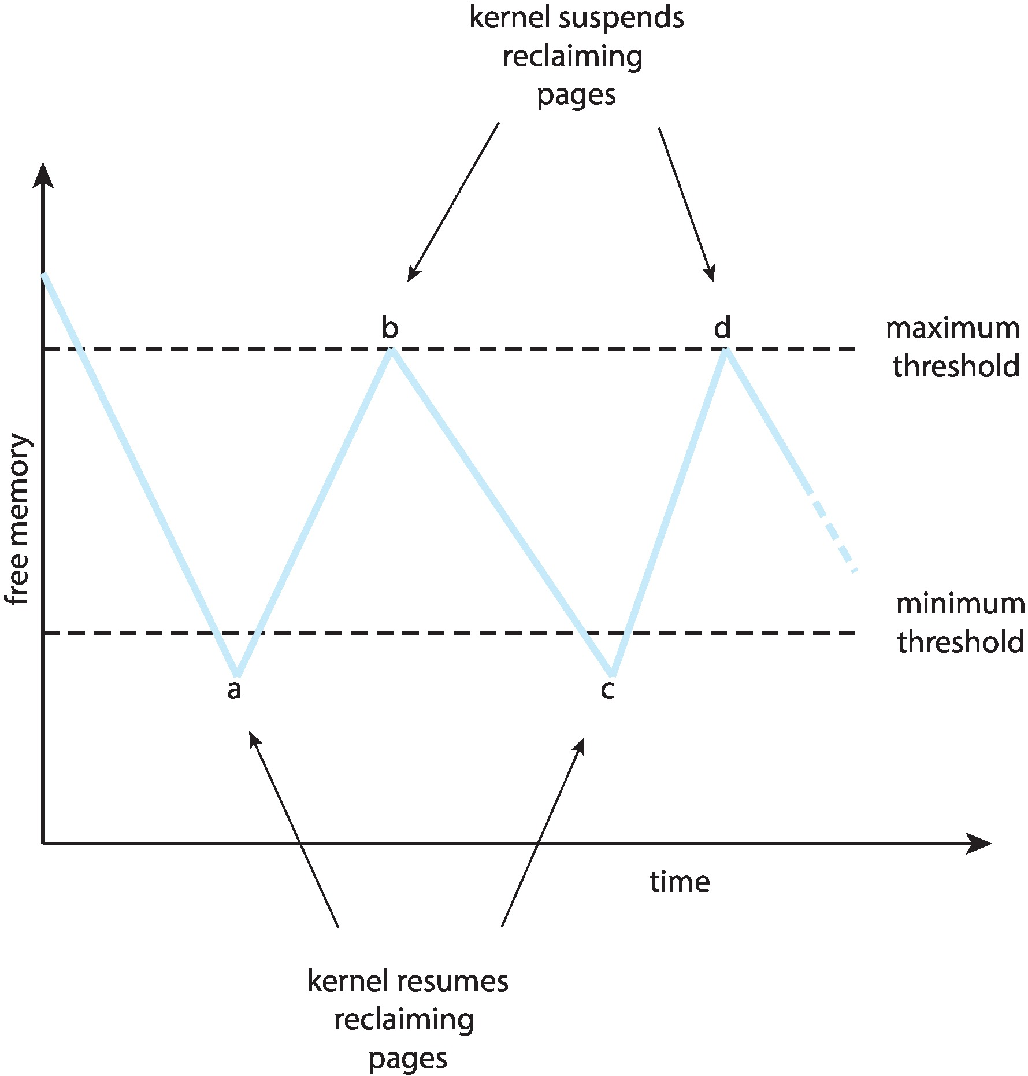
Reclaiming Pages Example

Slide 25
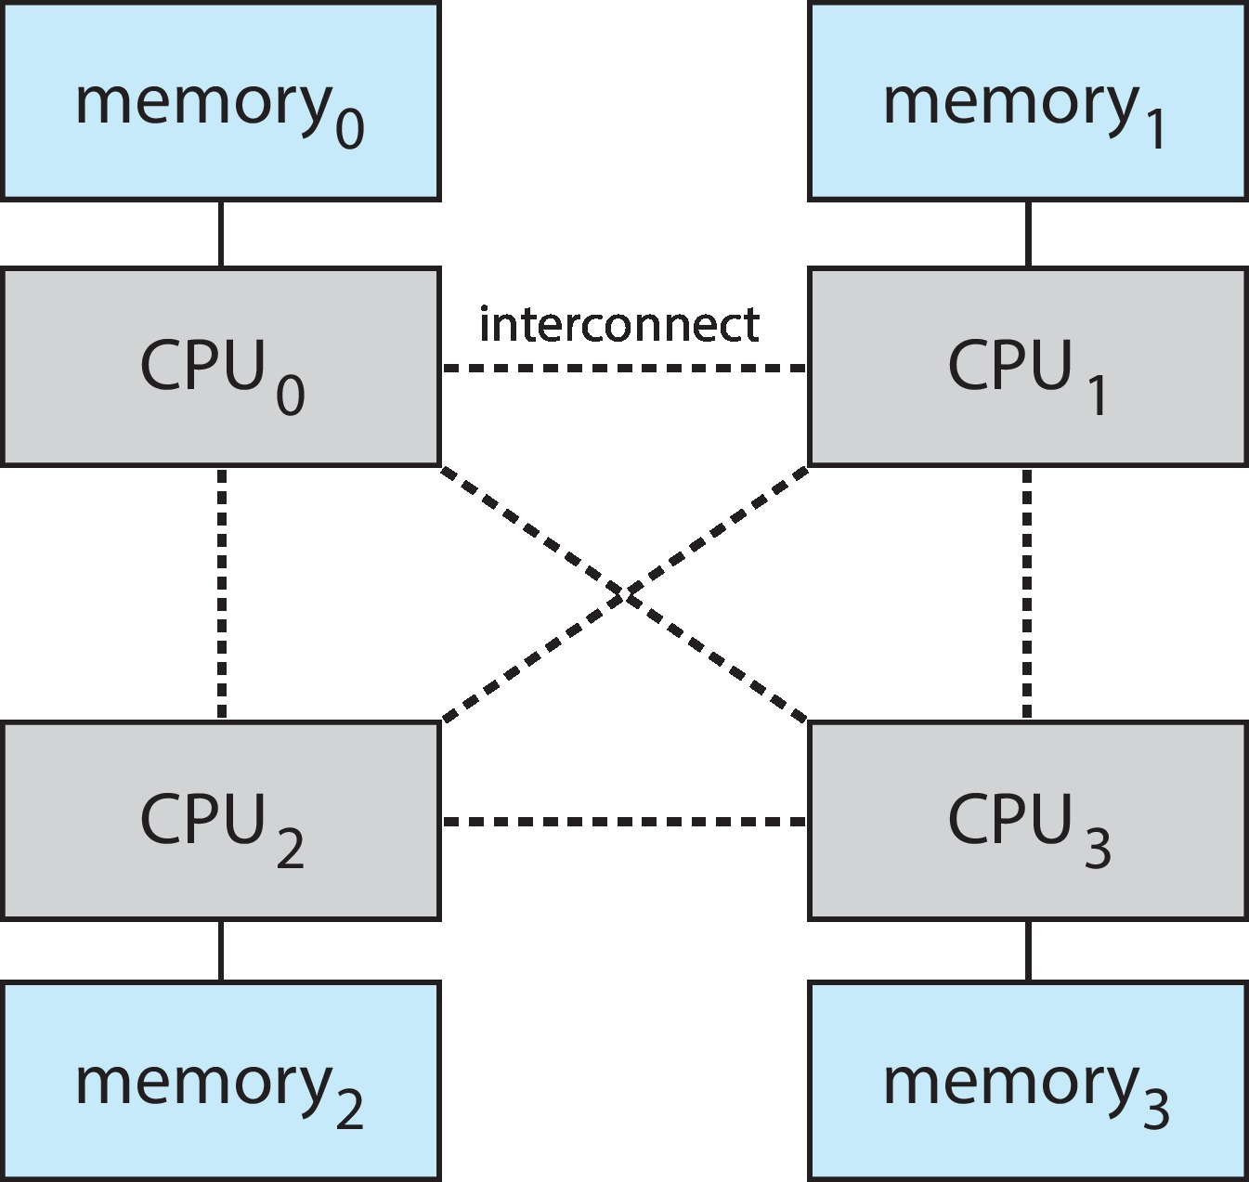
Non-Uniform Memory Access
So far all memory accessed equally
Many systems are NUMA – speed of access to memory varies
  Consider system boards containing CPUs and memory, interconnected over a system bus
NUMA multiprocessing architecture

Slide 26
Non-Uniform Memory Access (Cont.)
Optimal performance comes from allocating memory “close to” the CPU on which the thread is scheduled
  And modifying the scheduler to schedule the thread on the same system board when possible
  Solved by Solaris by creating lgroups
    Structure to track CPU / Memory low latency groups
    Used my schedule and pager
    When possible schedule all threads of a process and allocate all memory for that process within the lgroup

Slide 27
Thrashing
If a process does not have “enough” pages, the page-fault rate is very high
  Page fault to get page
  Replace existing frame
  But quickly need replaced frame back
  This leads to:
    Low CPU utilization
    Operating system thinking that it needs to increase the degree of multiprogramming
    Another process added to the system

Slide 28
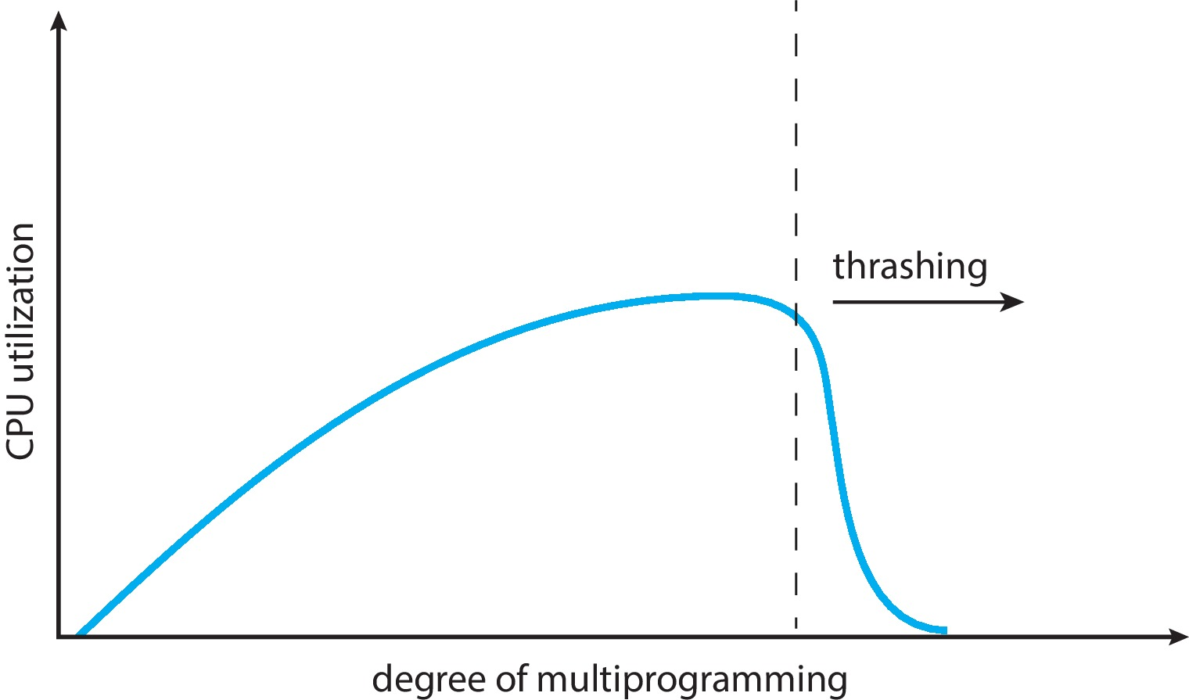
Thrashing (Cont.)
Thrashing. A process is busy swapping pages in and out

Slide 29
Demand Paging and Thrashing
Why does demand paging work?
Locality model
  Process migrates from one locality to another
  Localities may overlap
Why does thrashing occur?
Σ size of locality > total memory size
Solutions:
  Limit effects by using local or priority page replacement

Slide 30

Working-Set Model
Δ ≡ working-set window ≡ a fixed number of page references
Example: 10,000 instructions
WSS_{i} (working set of Process P_{i}) = total number of pages referenced in the most recent Δ (varies in time)
  if Δ too small will not encompass entire locality
  if Δ too large will encompass several localities
  if Δ = ∞ ⇒ will encompass entire program

Slide 31
Working-Set Model
D = Σ WSS_{i} ≡ total demand frames
  Approximation of locality
if D > m ⇒ Thrashing
Policy if D > m, then suspend or swap out one of the processes

Slide 32

Page-Fault Frequency
More direct approach than WSS
Establish “acceptable” page-fault frequency (PFF) rate and use local replacement policy
  If actual rate too low, process loses frame
  If actual rate too high, process gains frame

Slide 33
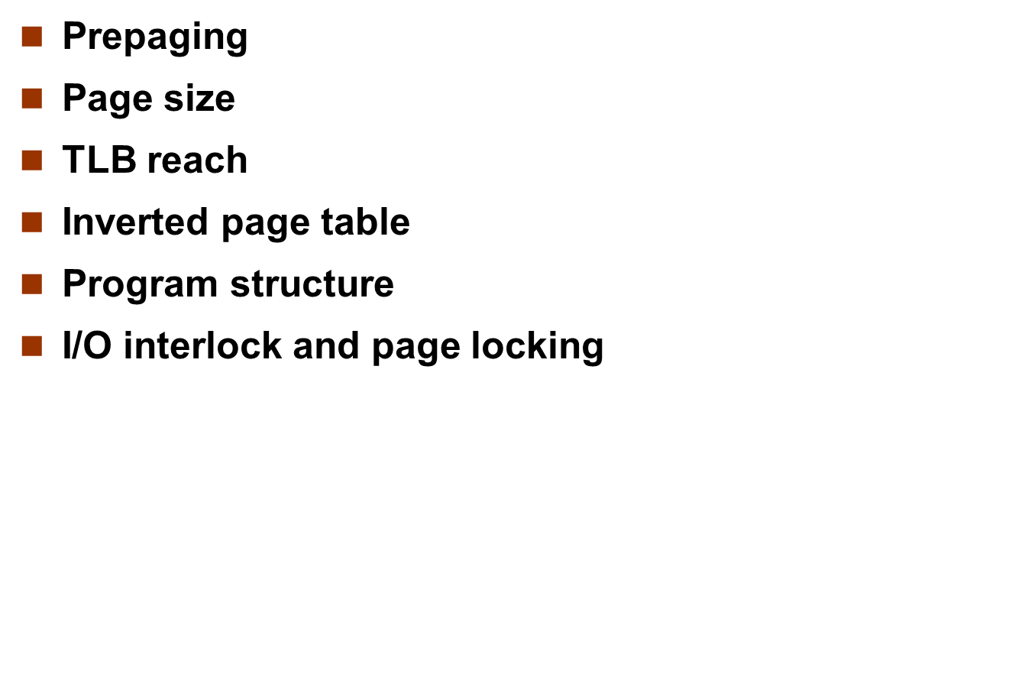
Other Considerations

Slide 34
Prepaging
To reduce the large number of page faults that occurs at process startup
Prepage all or some of the pages a process will need, before they are referenced
But if prepaged pages are unused, I/O and memory was wasted
Assume s pages are prepaged and α of the pages is used
  Is cost of s * α save pages faults > or < than the cost of prepaging
  s * (1- α) unnecessary pages?
  α near zero ⇒ prepaging loses

Slide 35
Page Size
Sometimes OS designers have a choice
  Especially if running on custom-built CPU
Page size selection must take into consideration:
  Fragmentation
  Page table size
  I/O overhead
  Number of page faults
  Locality
  TLB size and effectiveness
Always power of 2, usually in the range 2¹² (4,096 bytes) to 2²² (4,194,304 bytes)
On average, growing over time

Slide 36
TLB Reach
TLB Reach - The amount of memory accessible from the TLB
TLB Reach = (TLB Size) X (Page Size)
Ideally, the working set of each process is stored in the TLB
  Otherwise there is a high degree of page faults
Increase the Page Size
  This may lead to an increase in fragmentation as not all applications require a large page size
Provide Multiple Page Sizes
  This allows applications that require larger page sizes the opportunity to use them without an increase in fragmentation

Slide 37
Program Structure
Program structure
  int[128,128] data;
  Each row is stored in one page
  Program 1
for (j = 0; j <128; j++)
for (i = 0; i < 128; i++)
data[i,j] = 0;
  128 x 128 = 16,384 page faults
  Program 2
  for (i = 0; i < 128; i++)
  for (j = 0; j < 128; j++)
  data[i,j] = 0;
  128 page faults

Slide 38
End of Virtual Memory

